Slide 1

Introduction to Basic Statistics
Alicia DeLouize
adelouiz@uoregon.edu
https://github.com/AMDeLouize/Statistics-Workshops

Slide 2
Overview
When and How to Consider Statistics
Measurement Design Statistics
Types of Variables
Variable Transformation and Manipulation
Data Distributions
Descriptive Statistics
Null Hypothesis Significance Testing
Statistical Assumptions
Inferential Statistics

Slide 3
When to Consider Statistics
Example Study Steps:
Determine objective
Determine conditions (IV’s and DV) & statistics
Determine methods
Write hypothesis
IRB approval (if needed)
Collect data
Run statistics
RESEARCH LITERATURE AND WRITE PAPER

Slide 4
How to Consider Stats Early
Research Objective: Determine which age group has the most anxiety, kids, teens, adults, or older adults.
IV: age groups (1 – 13, 14 – 25, 26-49, 50+)
DV: Anxiety Score
Determine statistical test:
Statistical test: One Way ANOVA
Verify statistical test meets your research objective/question:
https://methods.sagepub.com/which-stats-test
“The one-way analysis of variance (ANOVA) is used to determine whether there are any statistically significant differences between the means of two or more independent (unrelated) groups (although you tend to only see it used when there are a minimum of three, rather than two groups).”

Slide 5
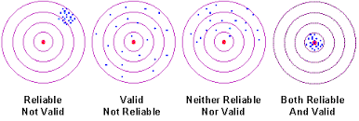
Measurement Design Statistics
Needs RELIABILITY and VALIDITY:

Slide 6
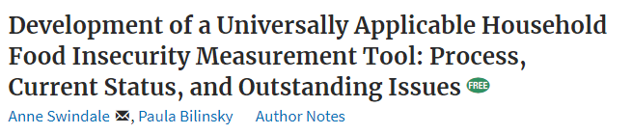
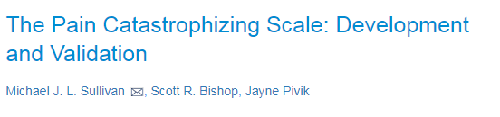
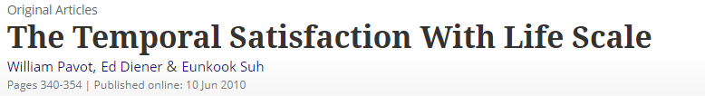
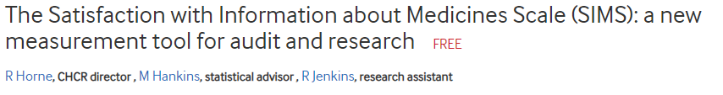
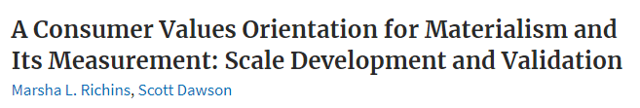
Measurement Design Statistics
Best bet: Use an already created and validated measure that you find in the literature
Can create one item measure – but will be subjective (e.g., rate health on a scale of 1 to 5)

Slide 7
Measurement Validity
Definition: Degree of overlap between measure and construct
- Content Validity: Measurement tool covers entire construct
-Lit review
-Ask people: experts and focus groups
-Factor analysis
- Criterion Validity: Extent measure is related to construct
-Concurrent: correlated to another determining factor (e.g., diagnosis)
-Predictive: only useful if it can predict things in the future (correlation)
- Convergent Validity: Extent two measurements of the same construct are related
-Statistical correlation between all measurement tools (e.g., of depression)
- Discriminant Validity: Extent two measurements are statistically unrelated if they are about different constructs (low correlation)
Notes:
Discriminant: want

Slide 8
Measurement Reliability
Internal Consistency
Cronbach’s alpha
Ranges from 0 (poor) to 1 (perfect)
If measure has internal consistency, you can create mean composite
The items measure the same construct
Test-retest reliability
Also called “Temporal Stability”
Correlation
Guideline: Aim for .75 or higher with .60 as minimum
Guideline: Aim for .50 or higher

Slide 9
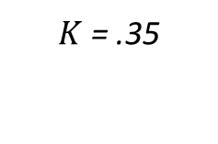
Measurement Reliability
Inter-rater reliability
Categorical: Cohen’s Kappa
Continuous: Intraclass Correlation (ICC)
PID | V1 | V2
1 | 1 | 1
2 | 1 | 1
3 | 1 | 1
4 | 0 | 0
5 | 1 | 1
6 | 1 | 1
7 | 0 | 0
8 | 1 | 0
9 | 1 | 0
10 | 0 | 1
PID | V1 | V2
1 | 1 | 1
2 | 2 | 3
3 | 3 | 4
4 | 3 | 4
5 | 4 | 5
6 | 4 | 5
7 | 1 | 2
8 | 1 | 2
9 | 2 | 3
10 | 3 | 4
 | 1 | 0
1 | 5 | 2 | 7
0 | 1 | 2 | 3
 | 6 | 4 | 10
$K$ = .35
Ranges for both: -1 (perfect disagreement) to 0 (no agreement) to 1 (perfect agreement)
ICC = .98

Slide 10
Measurement Reliability
Interpretation guidelines:
Kappa (Cohen, 1960) and ICC (Cicchetti, 1994)
Excellent | > .75
Good | .60 to .75
Fair | .40 to .59
Poor | < .40

Slide 11
Reliability and Validity Worksheet
Use the Reliability and validity reference handout to complete the worksheet handout

Slide 12
Types of Variables
Variable | Coding | Example
Dichotomous | 0 and 1 | Ever Schooled?
Nominal | 1,2,3,4, ect. | Ethnicity, type of food
Ordinal | 1-5 | Questionnaire question
Continuous | 1-100 | Hb, Height, Time
Can change the same data into less complex variable types:
- Continuous Hb -> Dichotomous Anemia yes/no
Not normal Nominal Variable -> Normal Dichotomous variable
Scale variable -> Nominal Variable -> Dichotomous variable

Slide 13
Variable Transformation and Manipulation
Other ways to manipulate variables:
- Add or subtract
- Multiply or divide
- Average
- Turn count data into percentage data
- Square or square-root
- Log transform (turns not normal variables normal)
- z-score (standardizes variables)
- only use a subset of your cases

Slide 14
Variable Manipulation Worksheet

Slide 15
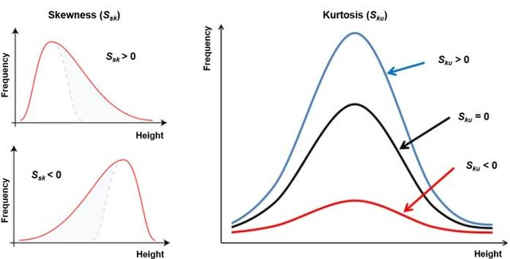
Data Distributions

Slide 16
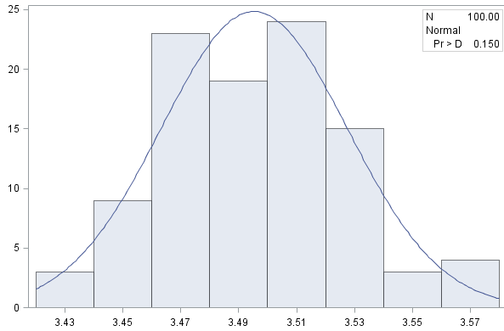
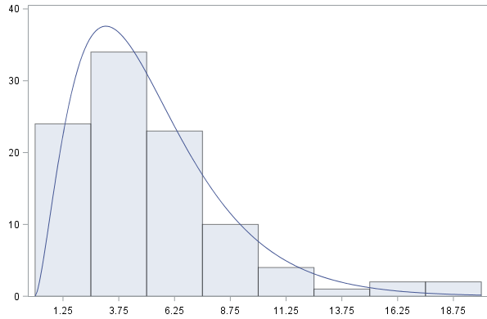
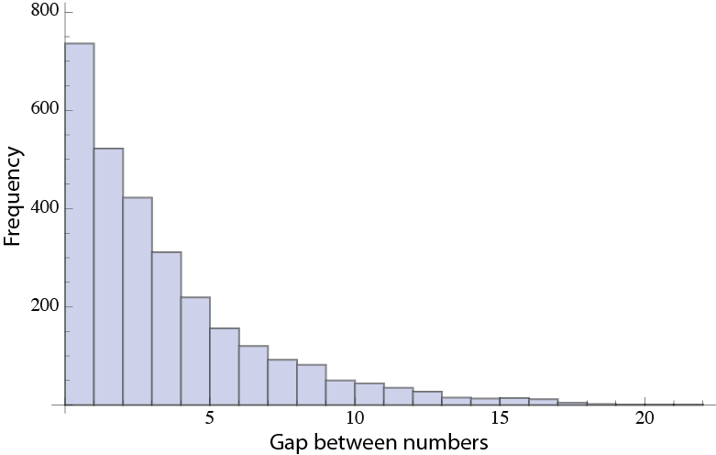
Data Distributions
Evaluate with a HISTOGRAM
Normal
Chi-Squared
Exponential

Slide 17
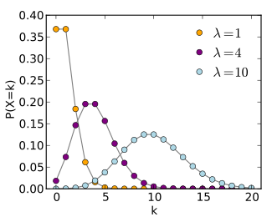
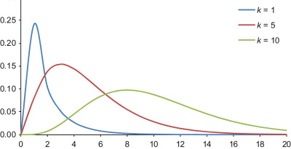
Data Distributions: Normality
Chi Squared (χ²) Distribution
Poisson Distribution
Increase Sample Size

Slide 18
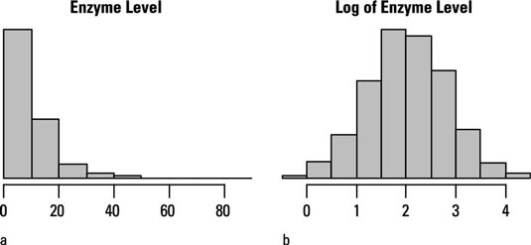
Data Distributions: Normality
Log transformation of exponential data distribution

Slide 19
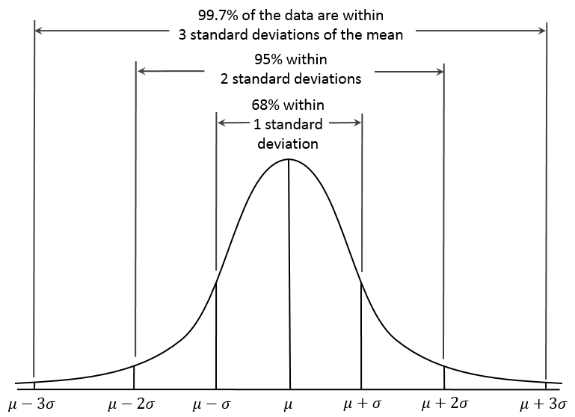
Descriptive Statistics
Describe sample using demographic variables and main variables
Categorical Variables
Frequency’s and percentages
Continuous variables
Mean
Standard Deviation

Slide 20
Null Hypothesis Significance Testing
Null hypothesis
p value
Level of Significance, Critical Value, α Value
p < .05
the conditional probability of achieving observed outcome if null hypothesis is true
based on sample size
NOT an effect size
no effect or no relationship based on data

Slide 21
Null Hypothesis Significance Testing
P Value
p < .05
p > .05
Common Language
“statistically significant” “unlikely due to chance”
“not significant”
“likely due to chance”
Statistical Statement
The null hypothesis was rejected
The null hypothesis could not be rejected

Slide 22
Statistical Assumptions
Normality
Homogeneity of Variances
Rule of thumb $s_{1}/s_{2}$ = 2
Rule of thumb 𝑠_1/𝑠_2 = 2
Levine's test for equality of variances: aim p > .05
Independent Score
Linearity of x and y Variables
Plot x vs. y variables
Multicollinearity
Predictors are not highly interrelated
Tolerance: aim > .3
Histogram
Skewness: aim <2 and > -2
Kurtosis: aim < 7 and > -7
Are participants only in data once?
Relationship looks straight, not curved
Plot x vs. y variables
Data dispersed evenly parallel to line

Slide 23
Inferential Statistics

Slide 24
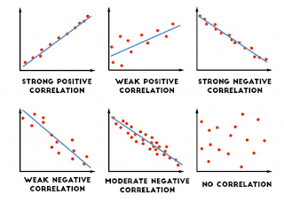
Correlation
IV: Continuous
DV: Continuous
Test: Pearson’s r
IV: Number of chocolates eaten in a week
DV: HbA1c
r = .10
Small
r = .30
r = .50
Medium
Large

Slide 25
Correlation Worksheet

Slide 26
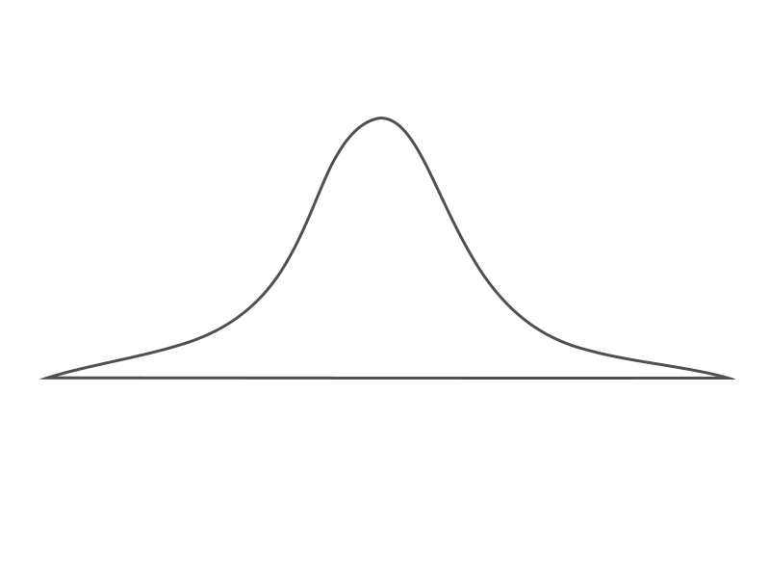
t-Test
IV: Binomial
DV: Continuous
T-test
Treatment
Placebo
IV: Treatment (Level 1 = treatment, Level 2 = Placebo)
DV: HbA1c
M = 2.3%
5.6%

Slide 27

ANOVA
IV: Categorical, Binomial
DV: Continuous
F-test = $\frac{\text{SS}\text{Between} \text{Groups}\text{/}\text{df}\text{Between} \text{Groups}}{\text{SS}\text{Within} \text{Groups}\text{/}\text{df}\text{Within} \text{Groups}}$ = $\frac{{MS}_{Between Groups}}{{MS}_{Within Groups}}$
Extent of variation between each persons score and grand mean
Total Variance
Extent of variation between each person’s group mean and the grand mean
Between Groups Variance
Extent of variation between each person’s score and their group mean
Within Groups Variance
Grand Mean
Group 1 Mean
Group 2 Mean
Within Group Variance
Between Group Variance
Notes:
Draw two examples on board – close together = BW/WI= small / large. Far apart = large / small

Slide 28
Two-Way ANOVA
Two-Way ANOVA
Exercise
No Exercise
MI
6.3
2.1
IV1: Exercise (Level 1 = exercise, Level 2 = no exercise)
IV2: Dementia (Level 1: Memory impaired, Level 2: Not memory impaired)
DV: Working memory
Not MI
10.1
8.6

Slide 29
Three-Way ANOVA
Diabetic
Pre-Diabetic
Healthy
Single
0.1
4.2
10.3
Woman
Taken
1.2
3.5
6.5
Three-Way ANOVA
Single
2.3
5.2
5.2
Man
Taken
1.1
3.7
7.3
DV: Chocolates Consumed on Valentine's Day

Slide 30
ANOVA Post-Hoc Tests
F-test tells you if there is a difference between groups, but not WHICH groups
- If only two levels, then compare means
- If three or more levels, run post hoc:
- LSD (Least Square Difference) – Similar to running a bunch of t-tests
- No adjustment for multiple comparisons, increases type I error
- Most likely to find significance (no reduction in power)
- Tukey’s HSD
-Moderately controls for type I error
- Bonferroni
-Controls for type I error
-Least likely to find significance (high reduction in power)

Slide 31
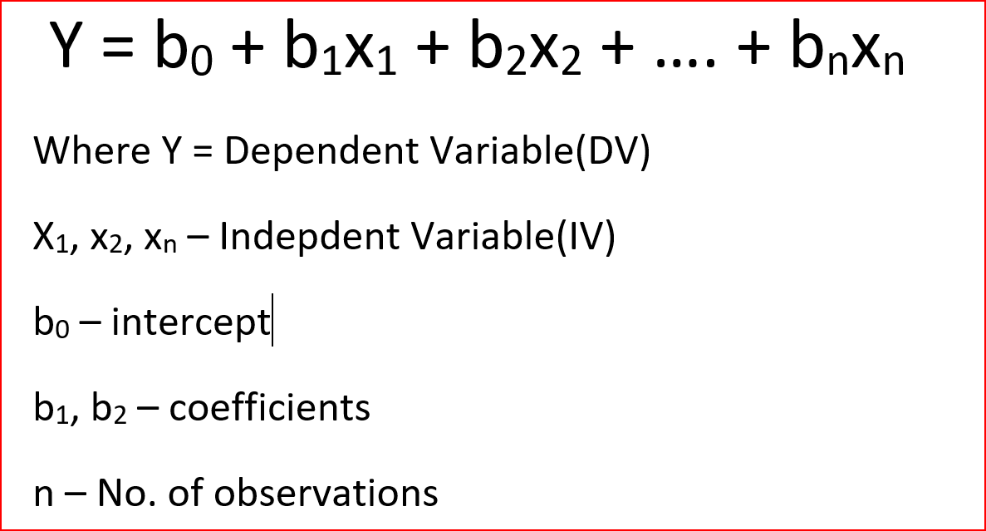
Multiple Regression
IV: Binomial, Continuous
DV: Continuous
Example
HbA1c
Chocolates Consumed on Valentines, Waist Circumference, Age, Gender
Notes:
Draw graph on board with normal curves

Slide 32
Regression: Multicollinearity
HbA1C
Choc. On V-Day
Gender
WC
Age

Slide 33
Chi-Squared Test
IV: Categorical, Binomial
DV: Categorical, Binomial
IV: Gender
DV: Food types eaten in a day
 | Veggies | Fruits | Meats
Male | 2 | 6 | 3
Female | 4 | 4 | 1
But… needs to have value of at least 5 in each cell!
 | Veggies | Fruits | Meats
Male | 18% | 55% | 27%
Female | 44% | 44% | 11%
$χ^{2}$ = $\frac{\text{sum} \text{of} \text{observed} \text{frequencies}\text{ – }\text{chance} \text{frequencies}}{Chance frequencies}$

Slide 34
Choosing a Test Worksheet
This is the last activity, make sure you have signed in then feel free to leave! Thanks for coming!!

